Slide 1


Thiago Macedo
11/21/2021

Slide 2

Outline
Executive Summary
Introduction
Methodology
Results
Conclusion
Appendix

Slide 3
Executive Summary
Methodologies:
Data was collected through web scraping of the SpaceX launches Wikipedia page and through the SpaceX public API.
The Exploratory Data Analysis was made through SQL queries, Matplotlib and Seaborn graphs, an interactive Plotly Dashboard and a Folium map, where geospatial data was analyzed.
Different Machine Learning models were created and later compared, in order to predict successful landings given the conditions of the launch.
Results:
Given the analysis of the models results, they all had similar predictions, with 83.33% of score.
The problem is that all models overpredicted successful landings, so more data is needed in order to improve accuracy.

Slide 4
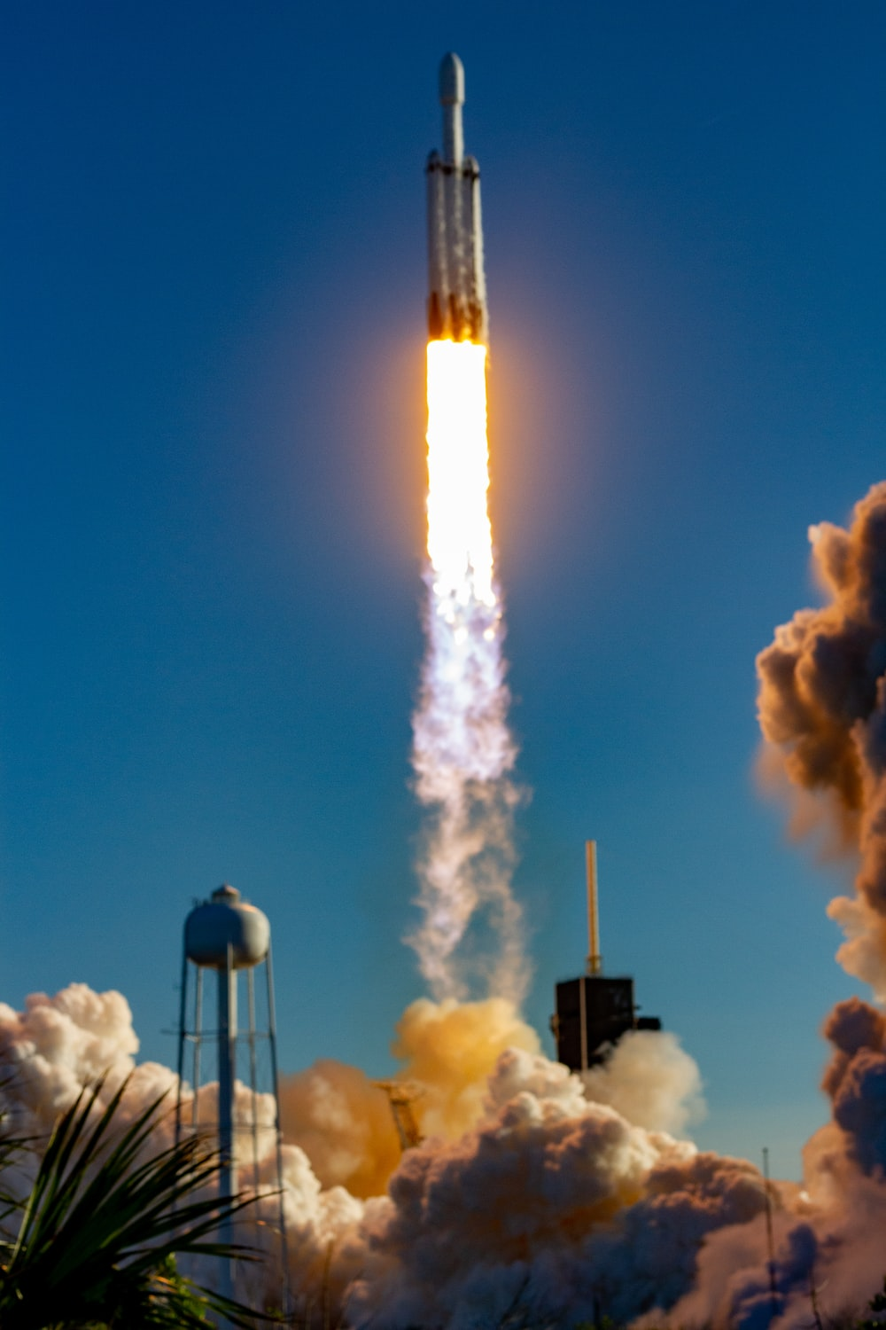
Introduction
Project background:
Space exploration is increasing daily and the commercial side of it’s starting to get appealing.
Everything is about money, and SpaceX can launch rockets into space cheaper than anyone. All that because they can reuse the first part of the rocket (Stage 1).
SpaceX can launch costs with $62 million dollars. Other companies need $165 million to the same thing.
A new space travel company, SpaceY (ironic) wants to beat SpaceX prices. Launching rockets for less than $62 million.
SpaceY needs to find a way to know how much they will spend in a launch.

Slide 5
The fact
If Space Y could predict either the Stage1 of the rocket would land succesfully, they could predict the price of the launch and that way get a smaller cost than SpaceX in the launches.
The problem
How could SpaceY predict either the Inicial part of the rocket would land succesfully or not?
What kind of data is needed in orther to predict the oucome of the landing?
What’s the best ML model to predict that variable?

Slide 6


Slide 7
Methodology
Executive Summary
Data collection methodology:
Combined Data from SpaceX API and Wikipedia page
Perform data wrangling
Used Pandas and NumPy to clean and reorganize the data
Perform exploratory data analysis (EDA) using visualization and SQL
Perform interactive visual analytics using Folium and Plotly Dash
Perform predictive analysis using classification models
Machine Learning models created with Scikit-Learn and tuned with GridSearchCV

Slide 8
BeautifulSoup
Data Collection Process
First part: SpaceX API Calls
SpaceX has a public API, with information about it’s launches, such as date, coordinates, rocket, Payload mass, outcome of the mission etc.
A get request was performed in order to retrieve the data
Second part: Scraping SpaceX launch data Wikipedia page
There is a Wikipedia page that contains data from past SpaceX launches.
Web scraping with Beautiful Soup library was performed in order to retrieve that data.

Slide 9
Data Collection – SpaceX API
GitHub URL for the Jupiter notebook related to this part of the project : https://github.com/macedoti13/DataScience-Capstone/blob/master/spacex-data-collection-api.ipynb
Requested and parsed the SpaceX launch data using the GET request
Filtered the dataframe to only include Falcon 9 launches
Dealed with Missing Values by replacing then with the mean

Slide 10
Data Collection - Scraping
GitHub URL for the Jupiter notebook related to this part of the project: https://github.com/macedoti13/DataScience-Capstone/blob/master/webscraping.ipynb
Requested the Falcon9 Launch Wiki page from its URL
Extracted all column/variable names from the HTML table header
Created a data frame by parsing the launch HTML tables

Slide 11
Data Wrangling
GitHub URL for the Jupiter notebook related to this part of the project: https://github.com/macedoti13/DataScience-Capstone/blob/master/spacex-Data%20wrangling.ipynb
Calculated the number of launches on each launch site
Calculate the number and occurrence of each orbit
Calculated the number and occurrence of mission outcome per orbit type
Created a landing outcome label from Outcome column

Slide 12
EDA with Data Visualization
Charts plotted:
Flight Number x Launch Site (scatterplot)
Payload x Launch Site (scatterplot)
Success Rate x Orbit type (barplot)
Flight Number x Orbit type (scatterplot)
Payload x Orbit type (scatterplot)
Launch Success yearly trend (lineplot)
GitHub URL: https://github.com/macedoti13/DataScience-Capstone/blob/master/EDA-with-Pandas.ipynb

Slide 13
EDA with SQL
Queries Realized:
Names of the unique launch sites in the space mission
5 records where launch sites begin with the string 'CCA’
Total payload mass carried by boosters launched by NASA (CRS)
Average payload mass carried by booster version F9 v1.1
Date when the first successful landing outcome in ground pad was achieved.
Names of the boosters which have success in drone ship and have payload mass greater than 4000 but less than 6000
Total number of successful and failure mission outcomes
Names of the booster versions which have carried the maximum payload mass
Failed landing outcomes in drone ship, their booster versions, and launch site names for in year 2015
Rank of the count of landing outcomes between the date 2010-06-04 and 2017-03-20
GitHub URL: https://github.com/macedoti13/DataScience-Capstone/blob/master/EDA-with-SQL.ipynb

Slide 14
Build an Interactive Map with Folium
Objects added to the map:
Circle and marker in each launch site (added to visualize them in the map)
Marker cluster of the successful and unsuccessful launches in each launch site (easy to visualize number of launches in every launch site)
Mouse Position (easy to get coordinates for the proximities of the launch sites)
Poly line (line between the launch site and it’s closest coastline
GitHub URL: https://github.com/macedoti13/DataScience-Capstone/blob/master/launch_site_location.ipynb

Slide 15
Build a Dashboard with Plotly Dash
The dashboard was created so the user could interact with it and decide what kind of data to see.
Features added to the Dashboard:
Dropdown menu so the user could choose what launch site data related to see.
An interactable bar so the user can choose the amount of Payload mass he wants to analyze
A scatter plot, to show how the amount of Payload mass affects the result of the landing.
A pie chart, to show the proportion of the successful and unsuccessful landings.
This pie chart only shows the data related to the launch site that was chosen in the dropdown menu
GitHub URL: https://github.com/macedoti13/DataScience-Capstone/blob/master/SpaceX_Dashboard.py

Slide 16
Predictive Analysis (Classification)
Separate the class column and tranform it into na array
Fit and transform the data with Standart Scaler
Split the data into training and testing data
Used GridSearchCV to find optimal parameters
Used GridSearchCV in Logreg, SVM, KNN and Decision Tree
Get the score of each model with the test data
Plot the confusion matrix for every models result
Comparison of every model score
Barplot to compare the scores
GitHub URL: https://github.com/macedoti13/DataScience-Capstone/blob/master/SpaceX_MLPrediction.ipynb

Slide 17
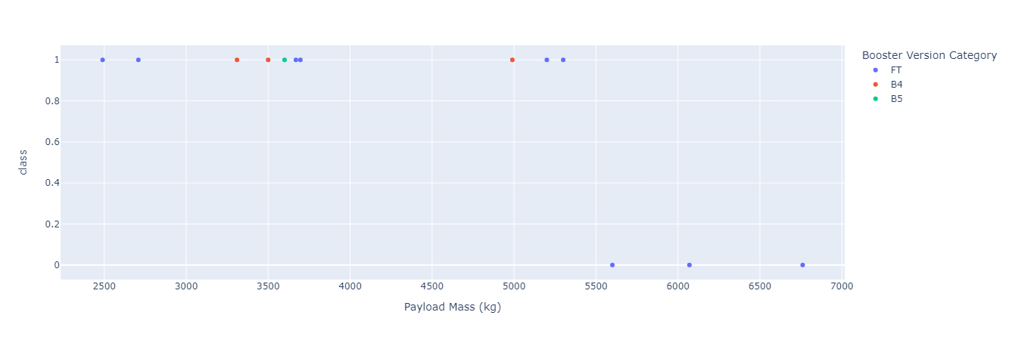
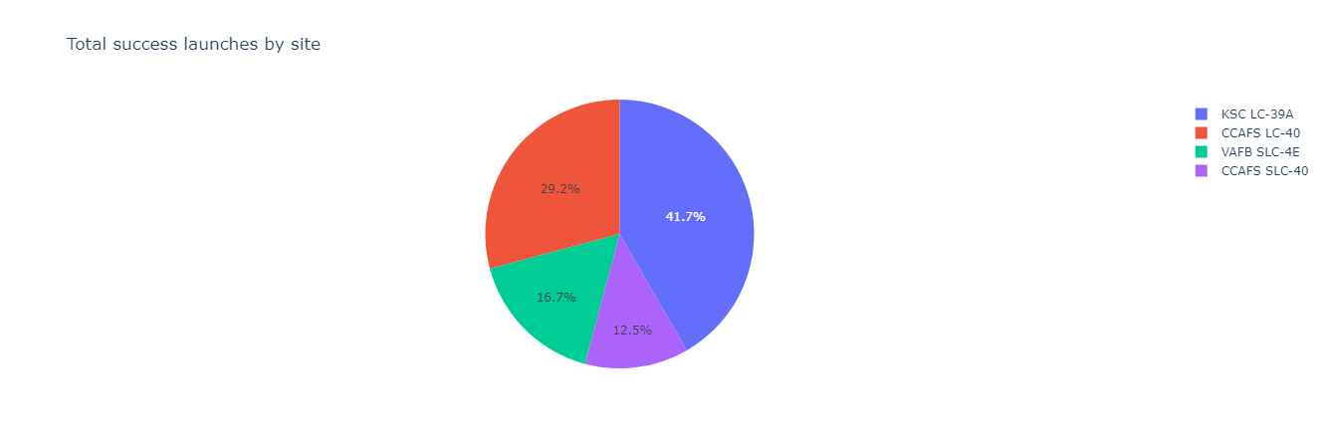
Interactive Dashboard Results
The results of the dashboard vary acording to the inputs of the user
The pie chart shows the proportion of succesfull and unsuccesfull landings for each launch site
The Scatter plot shows how the Payload mass interferes in the landings outcome.

Slide 18
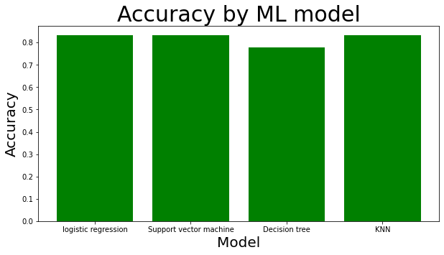
Interactive analysis Results
As we can see by the image, the accuracy of the different models is basically identical.
The logistic regression, SVM and KNN models had the same accuracy, of 83.33%.
The Decison tree model was the only one that got it’s accuracy below 80%.

Slide 19


Slide 20
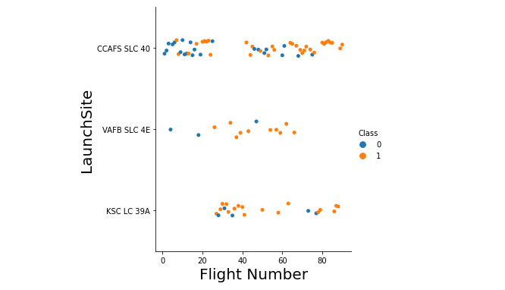
Flight Number vs. Launch Site
This plot suggests that the platform “CCAFS SLC 40” is the most used platform for SpaceX and that the number of successful landings (orange dots), increases as the flight number increases.

Slide 21
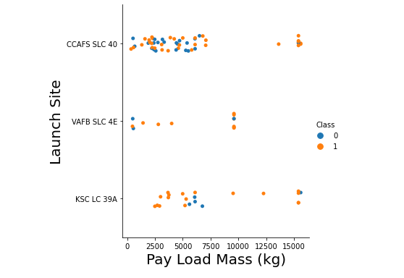
Payload vs. Launch Site
By analyzing this image, we can clearly see that most of the launches have a pay load mass under 7500kg.
We can also see that most of the launches with the payload mass above 7500kg have successful outcomes.

Slide 22
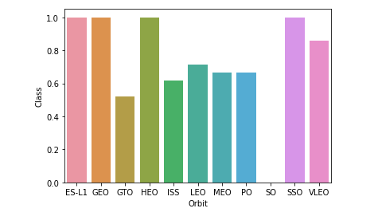
Success Rate vs. Orbit Type
The bar char tells us that all orbits have a success rate bigger than 50%
ES-L1, GEO, HEO and SSO have a success rate of 100%
Any mission has gone to SO orbit
GTO is the orbit with the lowest success rate (50%)

Slide 23
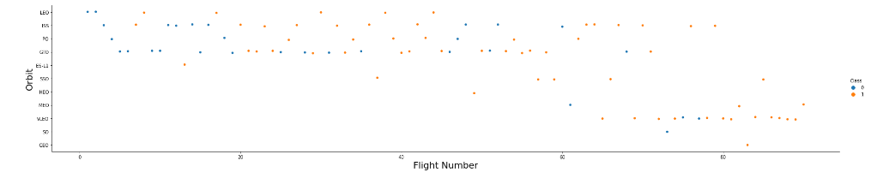
Flight Number vs. Orbit Type
What can we conclude by looking at the chart?
We can see that orbit choice changes as the flight number increases
There is a correlation between the orbit and the success rate

Slide 24
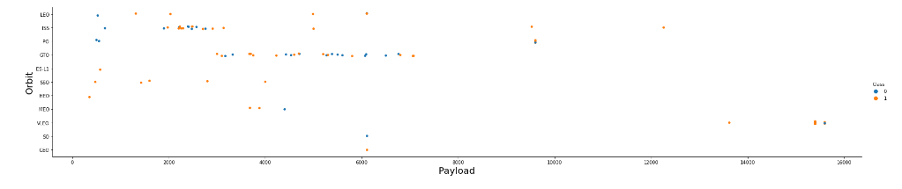
Payload vs. Orbit Type
What can we conclude by looking at the chart?
There is a clear relation between the payload and the orbit choice. Big payloads go to a very specific orbit
Most missions have a small payloads

Slide 25
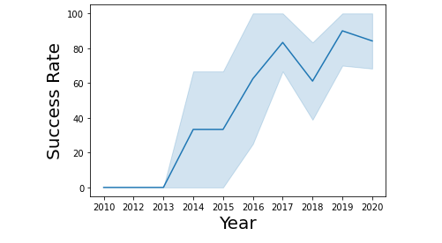
Launch Success Yearly Trend
We can clearly see that that the success rate increases as the years go by.
Missions started in 2013 and the success rate achieved its peak in 2019, when it got around 90%
In 2018, the success rate dropped quite heavily, for 60%

Slide 26
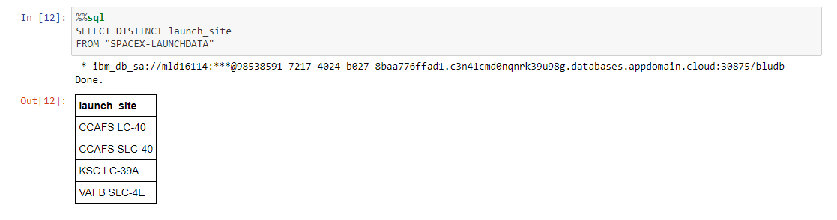
All Launch Site Names
The query shows four results, but ‘CCAFS LC-40’ is likely the same as ‘CCAFS SLC-40’

Slide 27
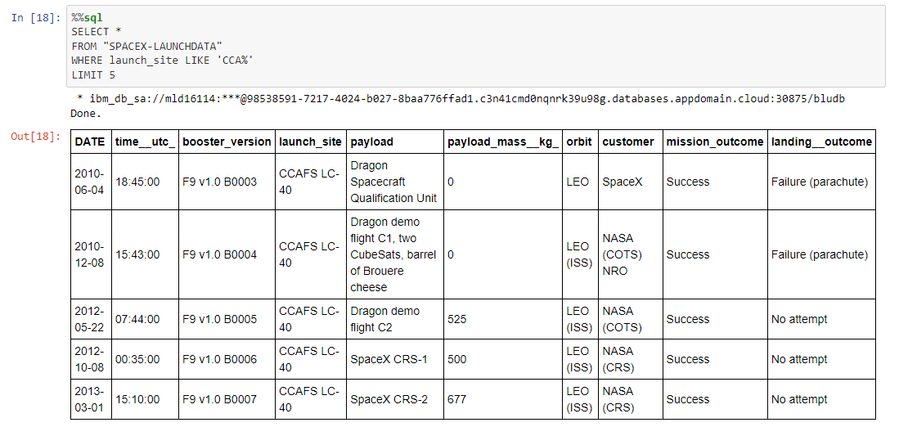
Launch Site Names Begin with 'CCA'
First 5 entry's that begin with ‘CCA’

Slide 28
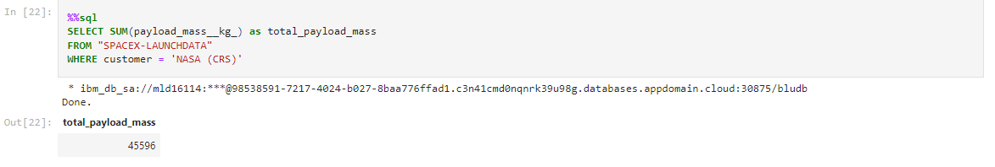
Total Payload Mass
We can see that the total payload mass of NASA is 45596

Slide 29
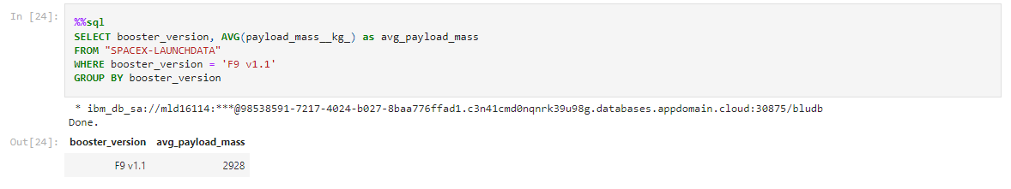
Average Payload Mass by F9 v1.1
We can see that the average payload mass for the booster version f9v1.1 is in the low end, with 2928 of average.

Slide 30
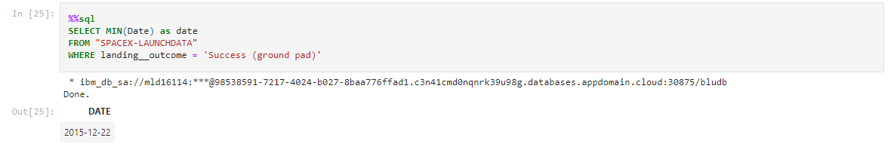
First Successful Ground Landing Date
The first successful landing was on December 22, 2015.

Slide 31
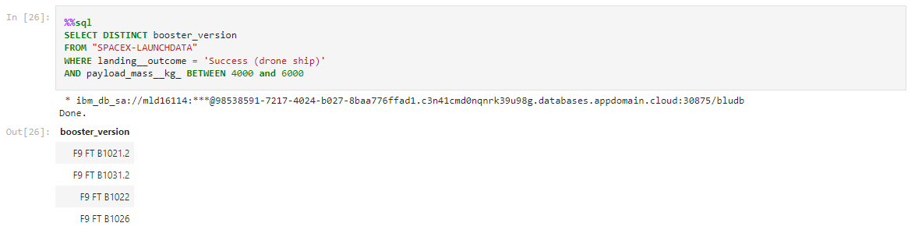
Successful Drone Ship Landing with Payload between 4000 and 6000
There are four different booster versions that landed successfully with the payload between 4000 and 6000

Slide 32
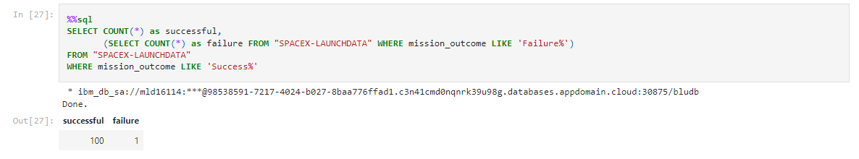
Total Number of Successful and Failure Mission Outcomes
There was 100 successful landings and only 1 failure

Slide 33
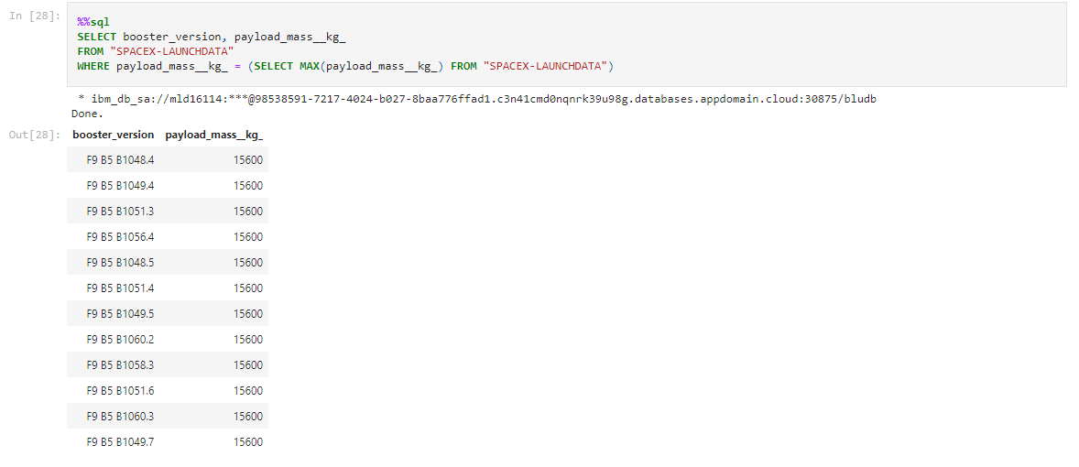
Boosters Carried Maximum Payload
This is the list of the booster versions that have caried the maximum payload

Slide 34
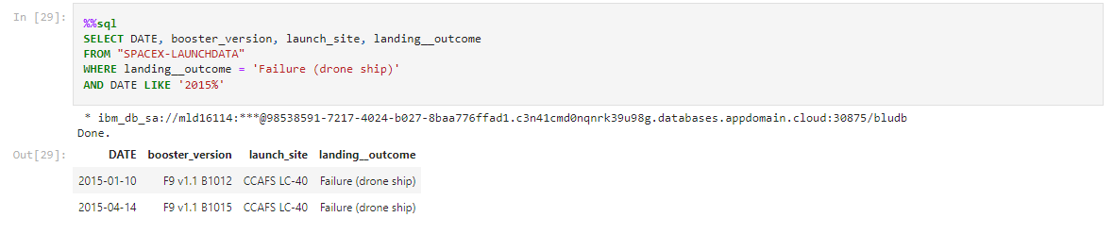
2015 Launch Records
Launch records of 2015

Slide 35
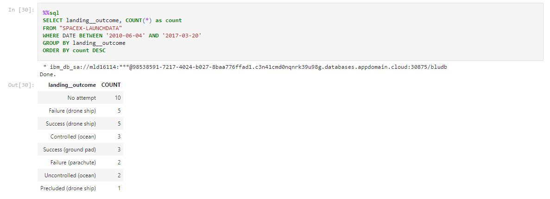
Rank Landing Outcomes Between 2010-06-04 and 2017-03-20
We can see that in most missions, there wasn’t an attempt to land the stage 1
We can also see that the success and failure in drone ship are in equal numbers

Slide 36


Slide 37
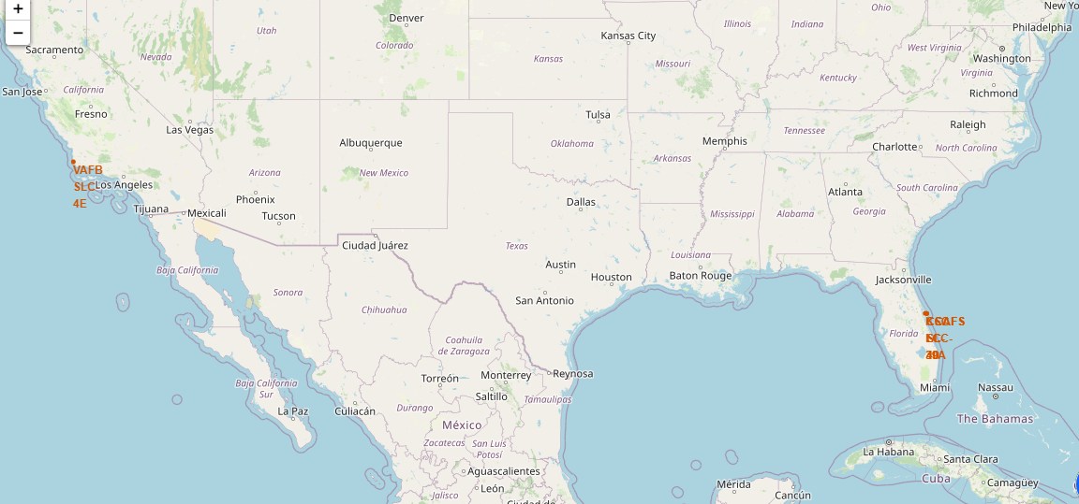
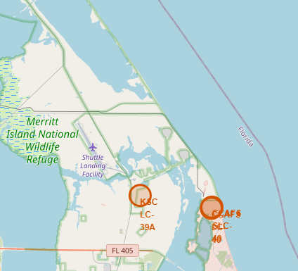
Launch Sites Locations
The first map shows all three launch sites in the US.
The second map shows both launch sites in Florida.
All launch sites are close to the coastline.

Slide 38
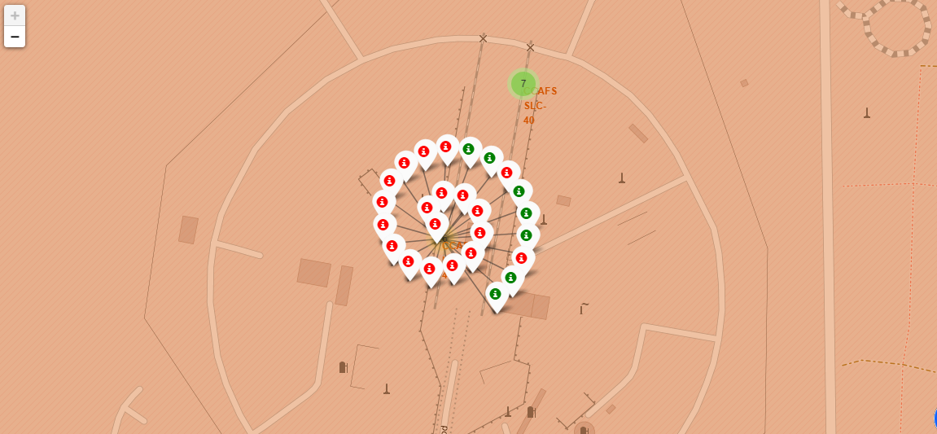
Launch Markers Florida
This are the color-coded markers of one of the Florida launch sites.
The red markers represent failed launches, and the green ones represents successful launches

Slide 39
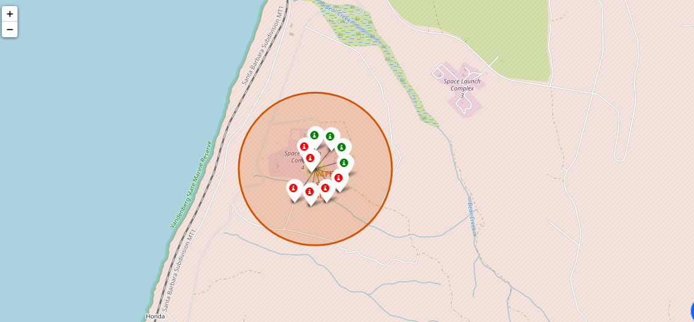
Launch markers California
In the california launch site, there were 4 succesfull lauches and 6 failed ones.

Slide 40
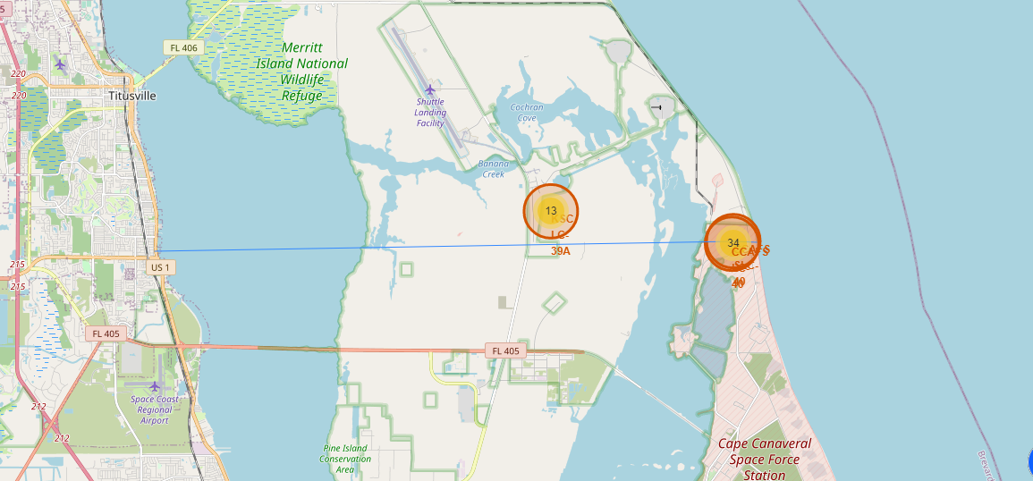
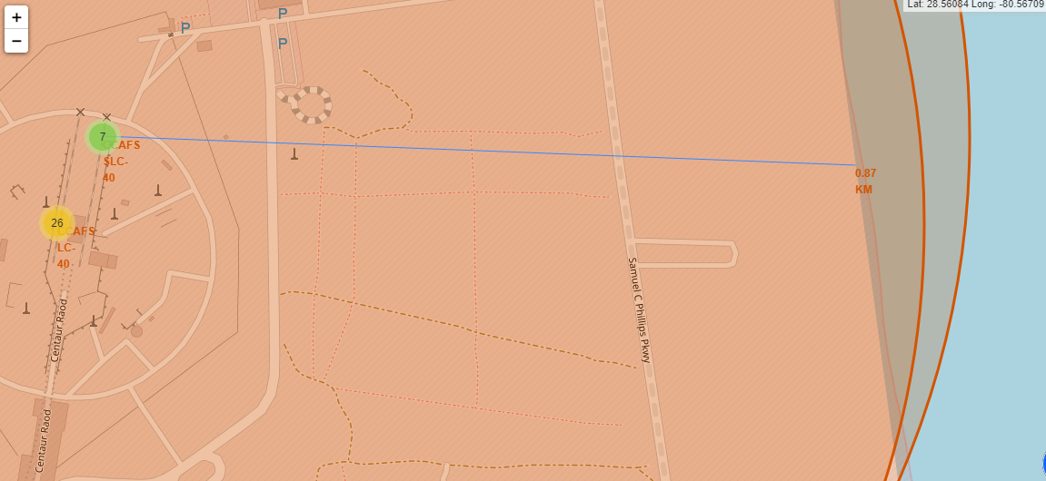
Key location proximities
Line between KSC LC-39 A and it’s closest coastline.
As we can see, launch sites are very far from cities and very close to the ocean.
Line between the KSC LC-39A launch site and it’s closest city, Tutisville.

Slide 41


Slide 42
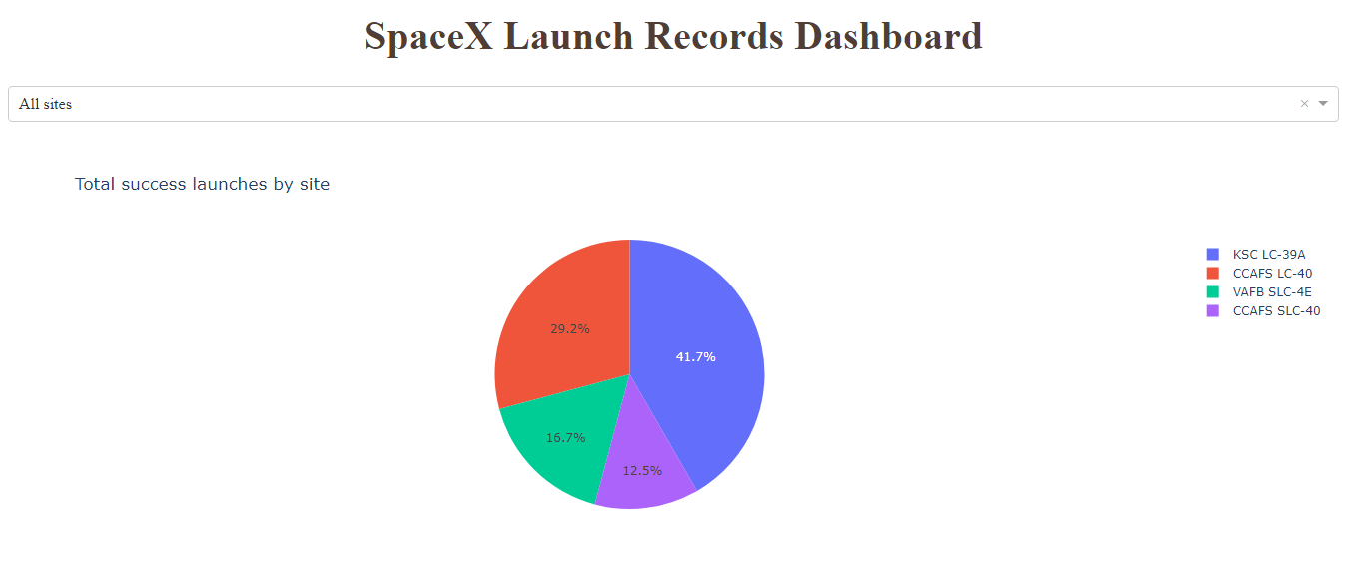
Successful launches number for all sites
We can see that KSC LC-39A has the biggest amount successful launches, with 41.7% of the total.

Slide 43
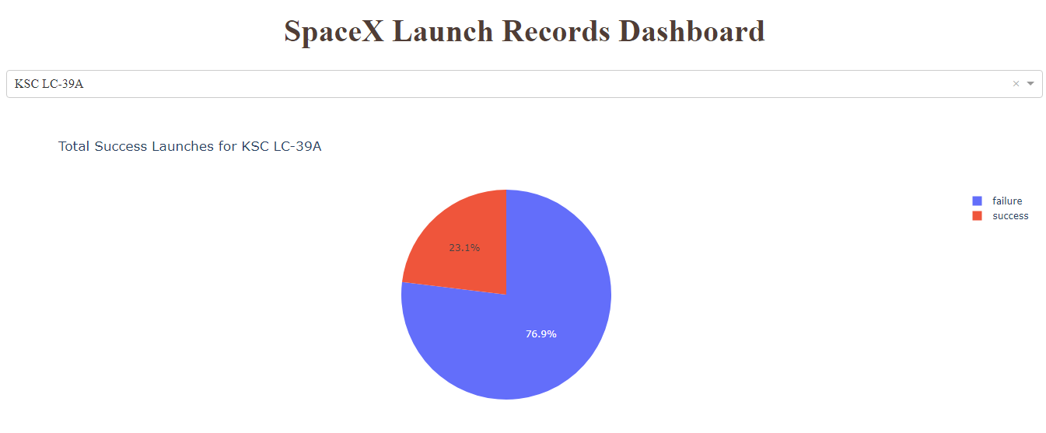
Launch site with the highest success ratio
KSC LC-39ª has the biggest success ratio among all launch sites. 76.9% of the launches there were successfull.

Slide 44
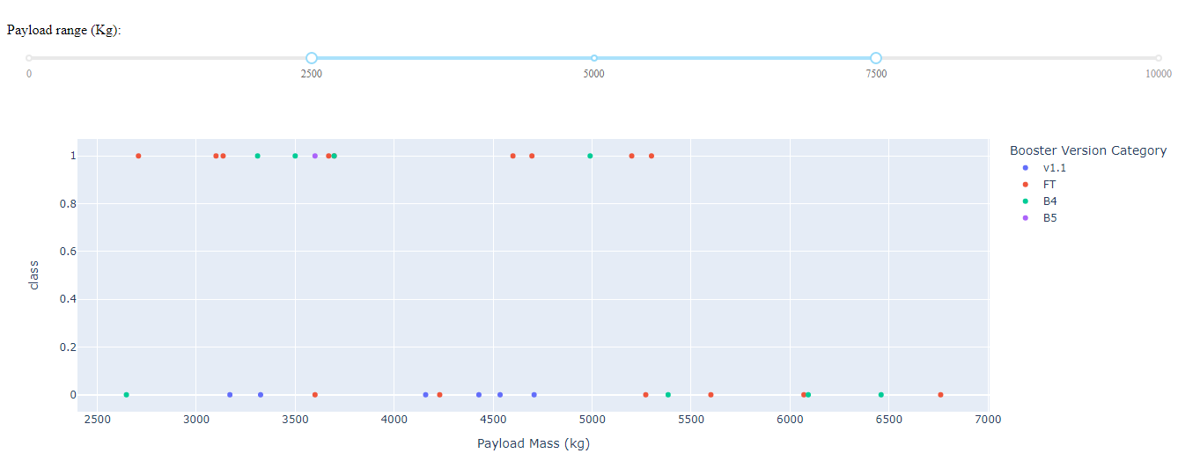
Success distribution for payload mass interval
We can see that, with the payload mass between 2500 and 7500, the FT booster version has the biggest number of succesfull launches
With the payload abouve 5500, there wasn’t any succesfull launch, with any booster version

Slide 45


Slide 46
Classification Accuracy
By the chart, we can see that all models had very close accuracy.
The logistic regression, support vector machine and KNN models all had the same accuracy of 83.33%.
The model with the lowest accuracy was the decision tree, with 76%.
Any of the three models with more than 80% of accuracy are a god choice for deployment.

Slide 47
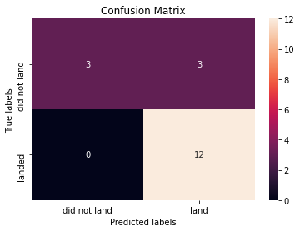
Confusion Matrix
All models had exactly the same confusion matrix
They all predicted all the correct unsuccessful landings (12)
The problem is that they aren’t very good in predicting good outcomes
They all predicted 6 good outcomes, but only got 3 right.
More data is needed In order to improve the god outcomes prediction

Slide 48
Conclusions
The point of the project is to be able to predict either the Stage 1 of the rocket will land successfully or not
Space Y needs to know that because they want to beat SpaceX, by having lower costs then them.
SpaceX launches data was retrieved through there API and Wikipedia page
The EDA occurred through SQL queries, and visualization with a Folium map, interactive dashboard and matplotlib’s graphics.
A Machine Learning model, with accuracy of 83.33% was created in order to predict if a landing was going to bee successful or not
Allon Mask’s SpaceY now has a good chance of beating Ellon Musk’s SpaceX

Slide 49
Appendix
GitHub repository url: https://github.com/macedoti13/DataScience-Capstone
All code, visualizations and documentation are there.
A special thanks to all coursera instructors who built this course, and for IBM, for offering this amazing certificate.
https://www.coursera.org/professional-certificates/ibm-data-science

Slide 50


